Slide 1


RFID ITEM LABEL PROPOSAL
2017. 3

Slide 2
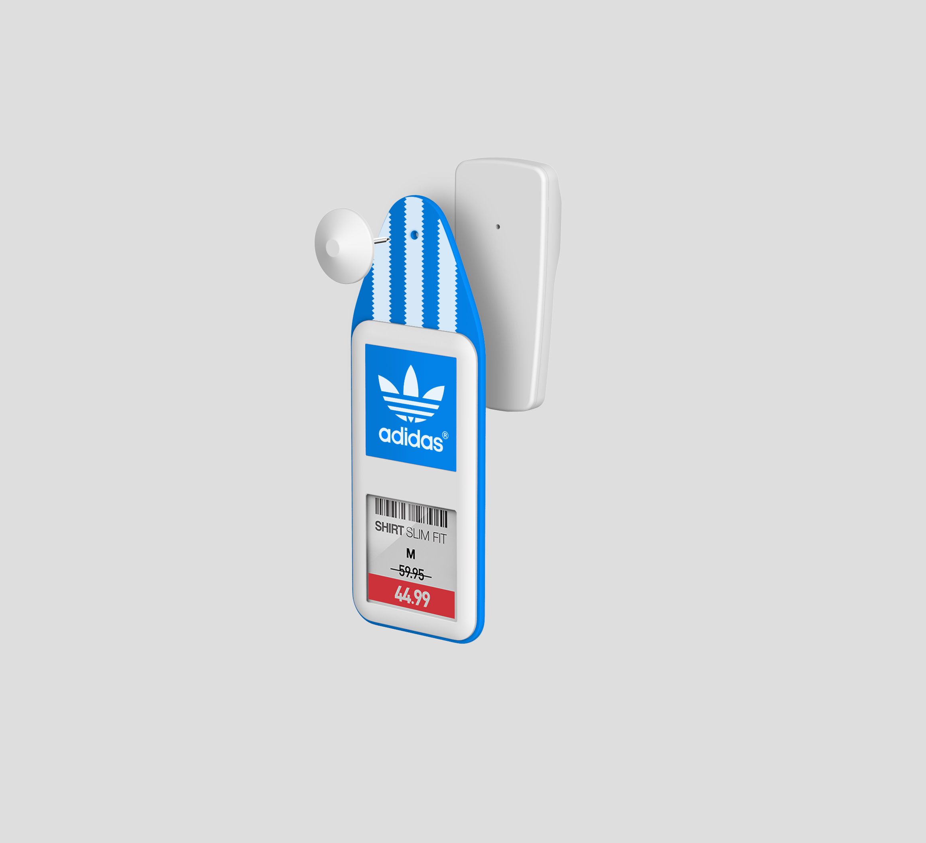

SOLUM RFID ITEM LABELS
2-IN-1 ITEM LABEL FUNCTIONS (GRAPHIC)
Security
Combined with 3rd party EAS hard-tag
Design
Customizable design & color
Inventory Management
Embedded RFID available
Zig-bee communication
Display & Dynamic Pricing
1.6” Graphical E-display
BW/BWR available

Slide 3
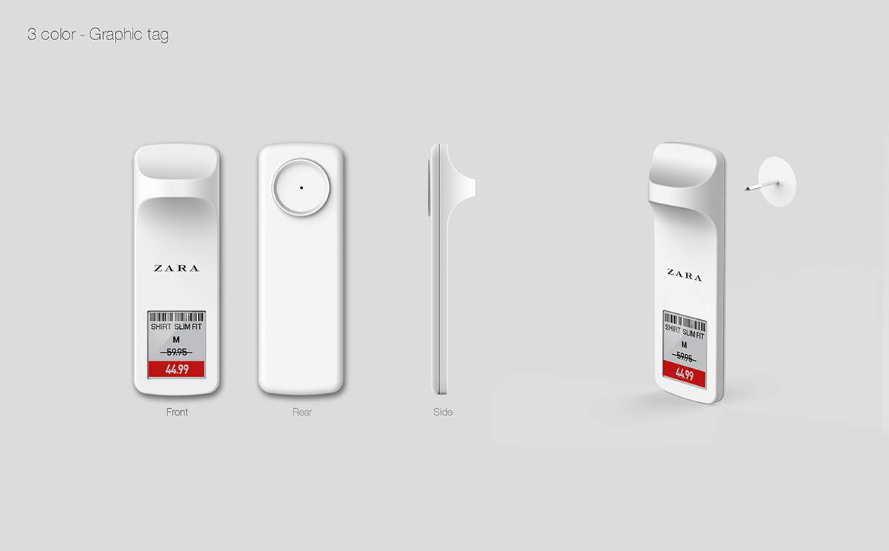
SOLUM RFID ITEM LABELS
3-IN-1 ITEM LABEL FUNCTIONS (GRAPHIC)
Security
Embedded EAS security system
Design
Customizable design & color
Inventory Management
Embedded RFID available
Zig-bee communication
Display & Dynamic Pricing
1.2” Graphical E-display
BW/BWR available

Slide 4
SOLUM RFID ITEM LABELS

Slide 5
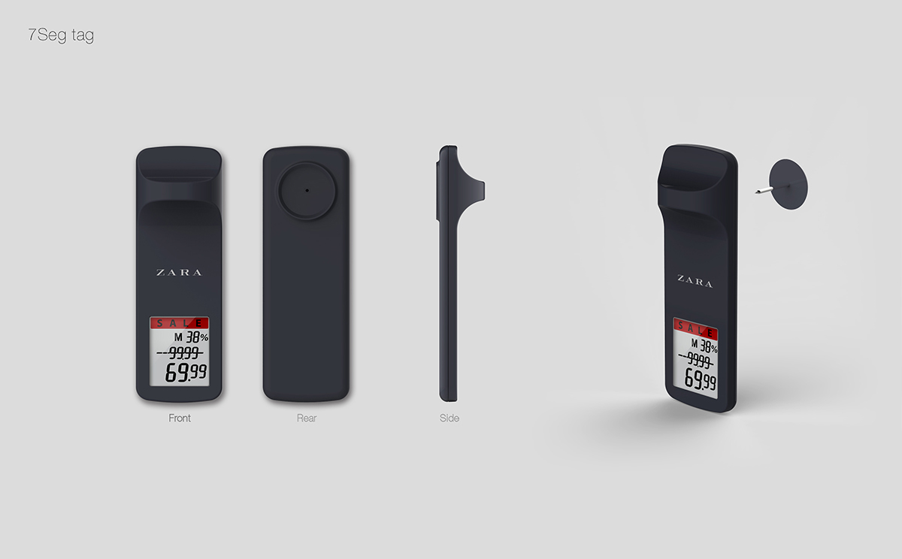
SOLUM RFID ITEM LABELS
3-IN-1 ITEM LABEL FUNCTIONS (SEGMENT)
Security
Embedded EAS security system
Design
Customizable design & color
Inventory Management
Embedded RFID available
Zig-bee communication
Display & Dynamic Pricing
1.2” Segment E-display
Cost effective

Slide 6
SOLUM RFID ITEM LABELS

Slide 7






BUSINESS MODEL1
STORE-TAGGING
SoluM provides labels to Macy’s without attaching to garments
and the attachment to garments(tagging) is done by store associates in store.
After sales, the labels are detached from garments (de-tagging) and collected in a box.
When new products arrive, the labels are re-attached(re-tagging) to them.
Advantages
Less delivery cost
Store level operation available
Disadvantages
More manual tagging needed in store
Store
Distribution Center
Manufacturing
Site
Distribution
Tagging / de-tagging
Collect
Re-tagging
Label Production

Slide 8

BUSINESS MODEL2
SOURCE-TAGGING
SoluM provides labels to Apparel Factory where the attachment is done by factory workers.
The garments are provided with attached labels from factory to Macy's.
After sales, the labels are detached from garments (de-tagging) and collected in a box.
The collected labels are sent to SoluM circulation center for cleaning and sent back to apparel factory for re-tagging.
Advantages
Less manual tagging needed in store
Disadvantages
Multi-store operation is needed (volume)
Store
Distribution Center
De-tagging
Collect
Apparel
Factory
Distribution
Circulation Center
Tagging
Re-tagging
Circulation
Cleaning

Slide 9


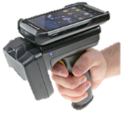





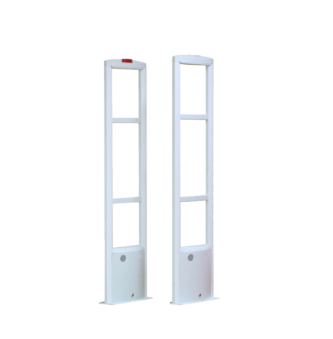


STORE PROCESS1
STORE OPERATION MAP (STORE-TAGGING)
Factory
Stock Room
Store
1
6
6
Zigbee
Zigbee
6
Cashier
Zigbee
$5.44 → &3.44
4
3
2
5
1
Label attachment by store associates
Label multi-assignment with RFID
Label multi-activation with RFID
3
Detachment & payment with RFID
Label de-activation with RFID
6
Automated price update
Real-time inventory tracking
Product location indicator
4
EAS security system
2
In-out counting with RFID
5
Collect & recycle to stock room

Slide 10
STORE PROCESS2
STORE OPERATION MAP (SOURCE-TAGGING)
Factory
Stock Room
Store
1
2
8
8
Zigbee
Zigbee
8
Cashier
Zigbee
$5.44 → &3.44
5
4
3
7
6
1
Label attachment in factory
Label multi-assignment with RFID
4
Detachment & payment with RFID
Label de-activation with RFID
7
Cleaning & maintenance
Re-send to factory
2
Label multi-activation with RFID
5
EAS security system
8
Automated price update
Real-time inventory tracking
Product location indicator
3
In-out counting with RFID
6
Collect & send to circulation center

Slide 11


THE VALUE OF RFID ITEM LABEL
AUTOMATED & DYNAMIC PRICING
$99
- Dynamic pricing based on real-time inventory status
- Automated price update
- No need of additional labor, paper and printing cost
- 100% accurate pricing and product information
- Online and offline pricing matching
$79
30%
mark down
$69
20%
mark down
C
E
purchase
order
D
A
B
Inventory Status
AUTOMATED INVENTORY VISIBILITY
- Automated inventory tracking with Zigbee communication.
- Product positioning by LBS solutions with Zigbec communication.
- High inventory accuracy by RFID counting.
- Product shrinkage protection by EAS security.
Zigbee
Real-time inventory tracking
Product location indicator
RFID
Circle- Counting

Slide 12
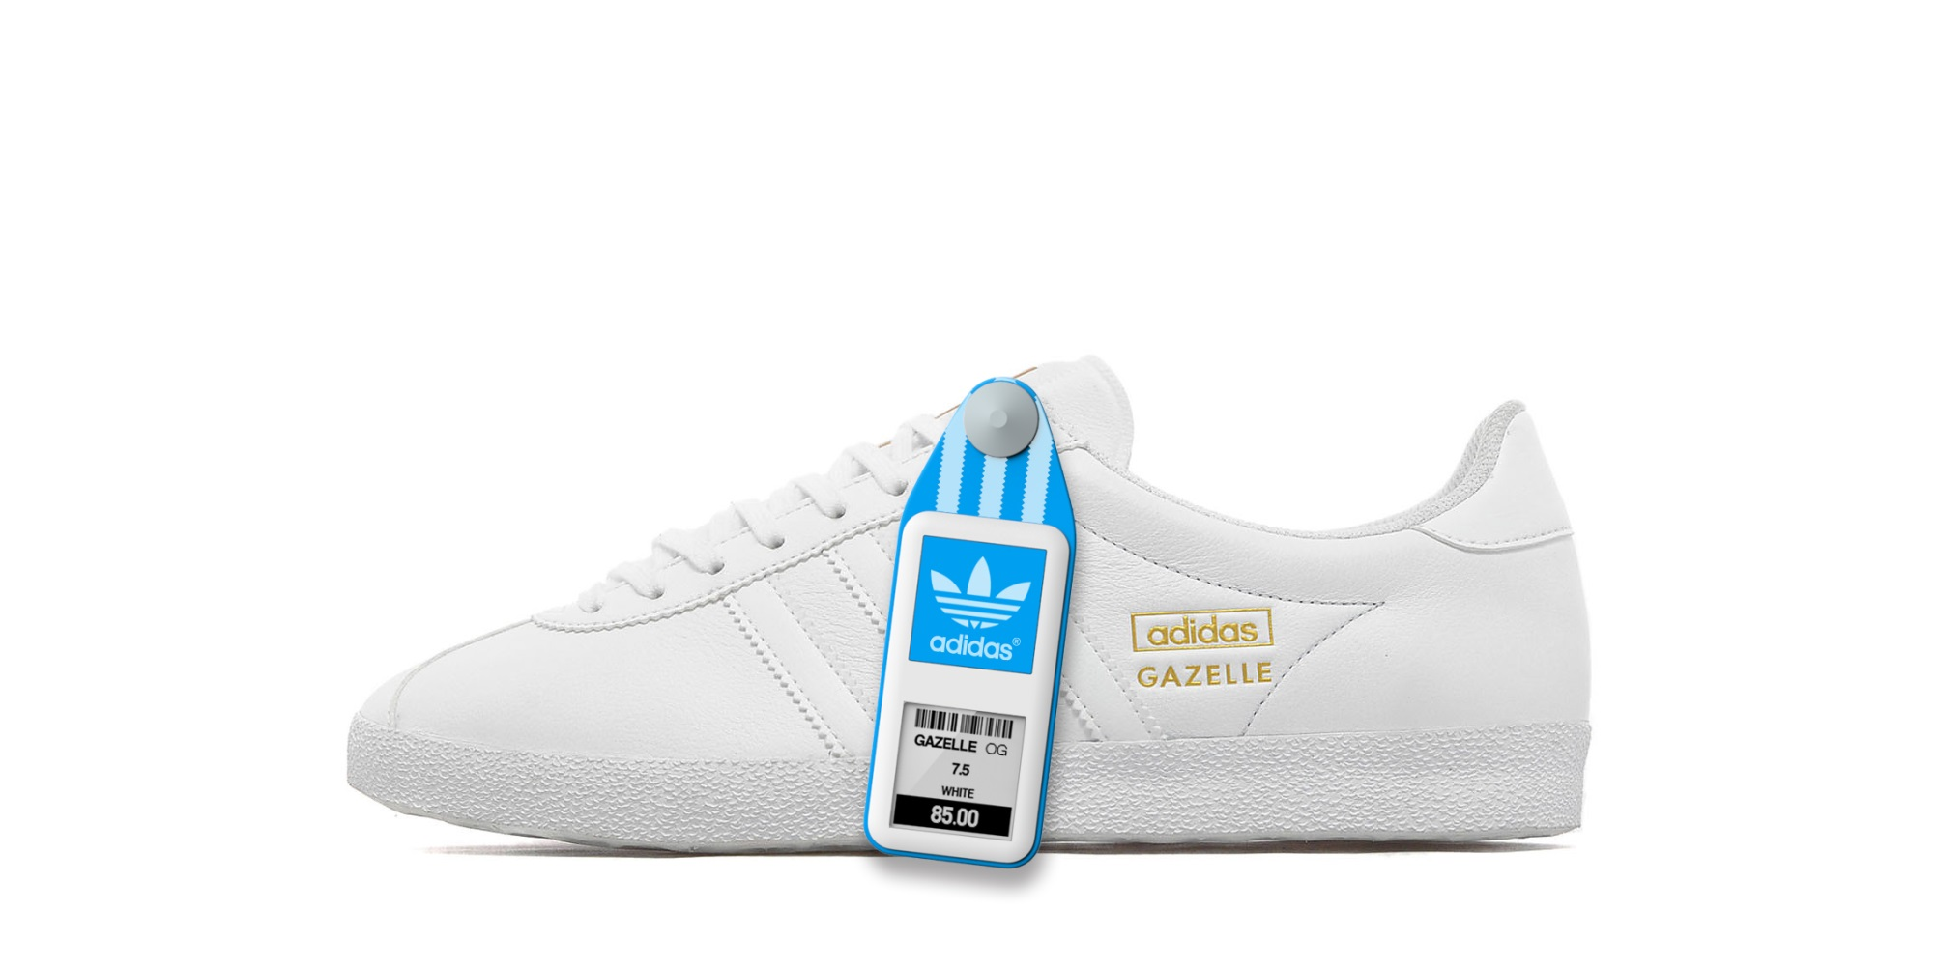
APPENDIX.
2-IN-1 ITEM LABEL (LIVE SHOT)

Slide 13
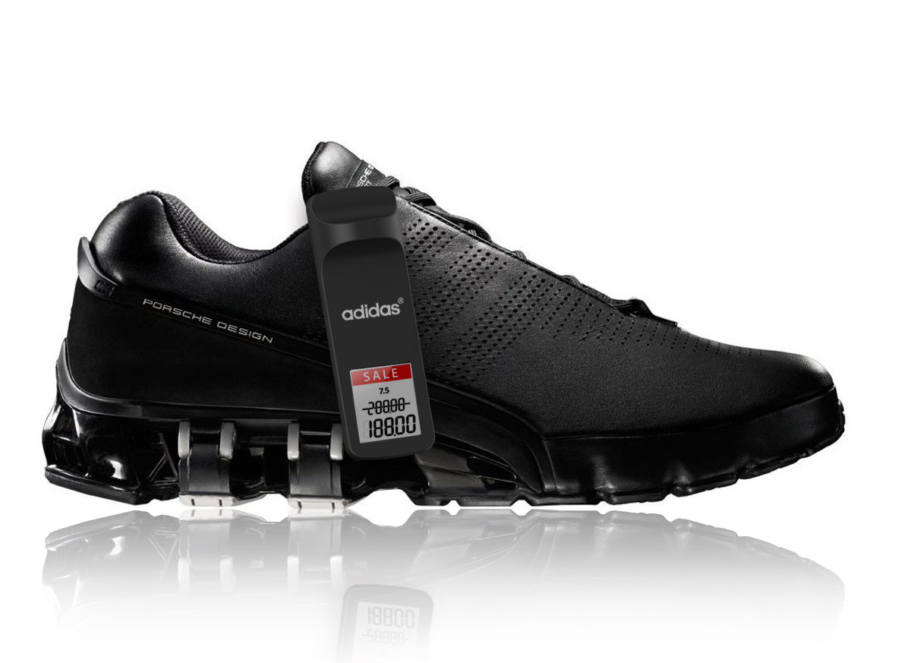
APPENDIX.
3-IN-1 ITEM LABEL (LIVE SHOT)

Slide 14
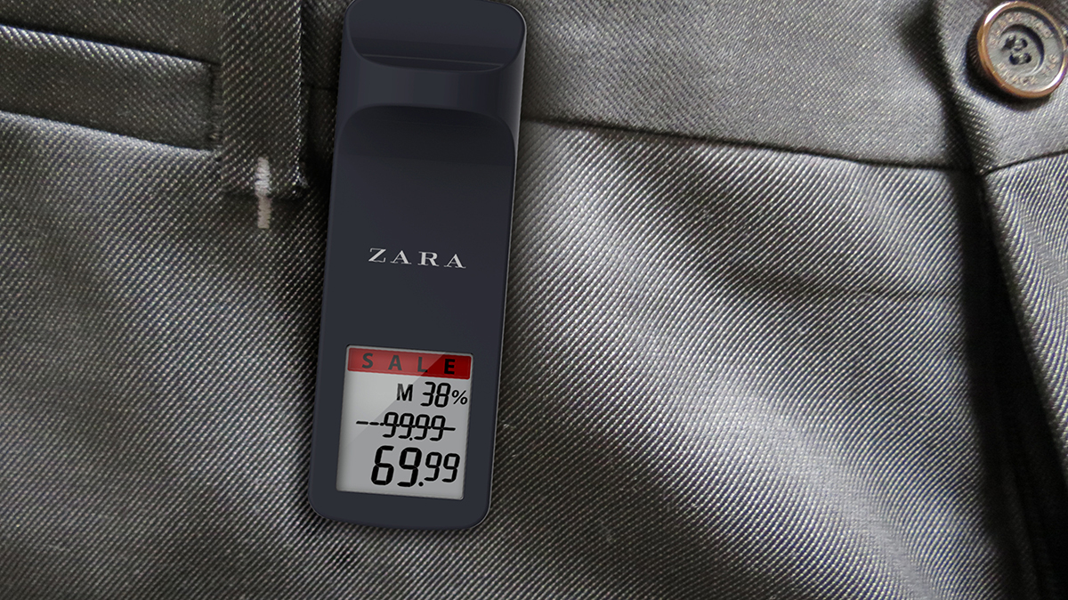
APPENDIX.
3-IN-1 ITEM LABEL (LIVE SHOT)

Slide 15
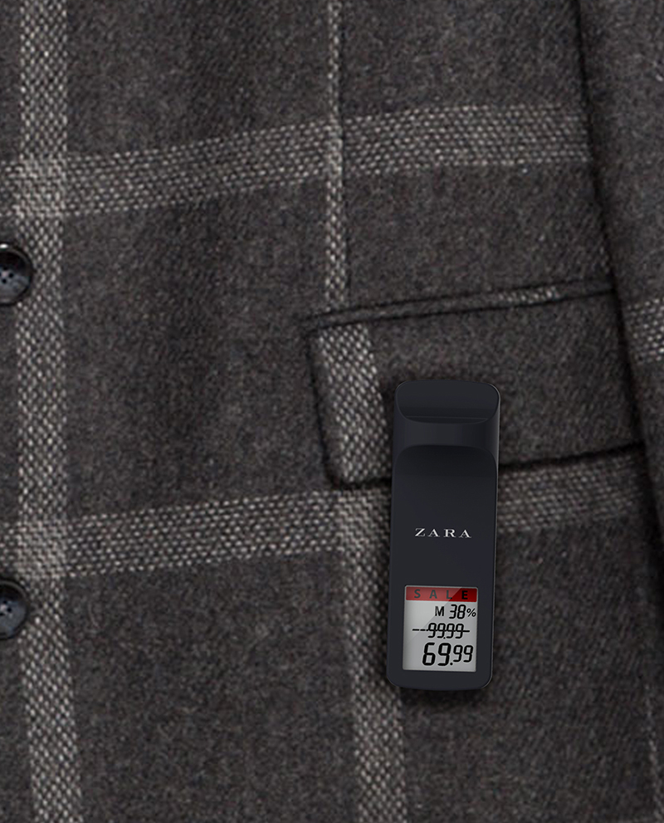
APPENDIX.
3-IN-1 ITEM LABEL (LIVE SHOT)

Slide 16
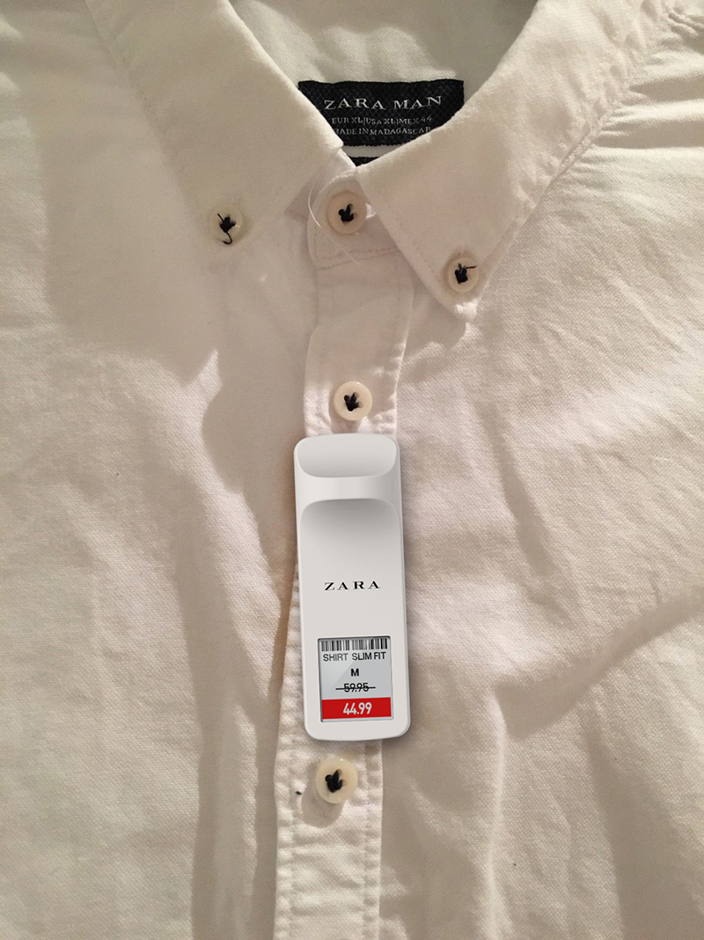
APPENDIX.
3-IN-1 ITEM LABEL (LIVE SHOT)

Slide 17
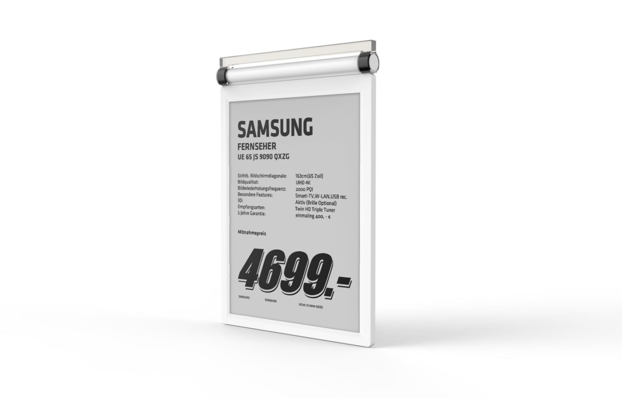
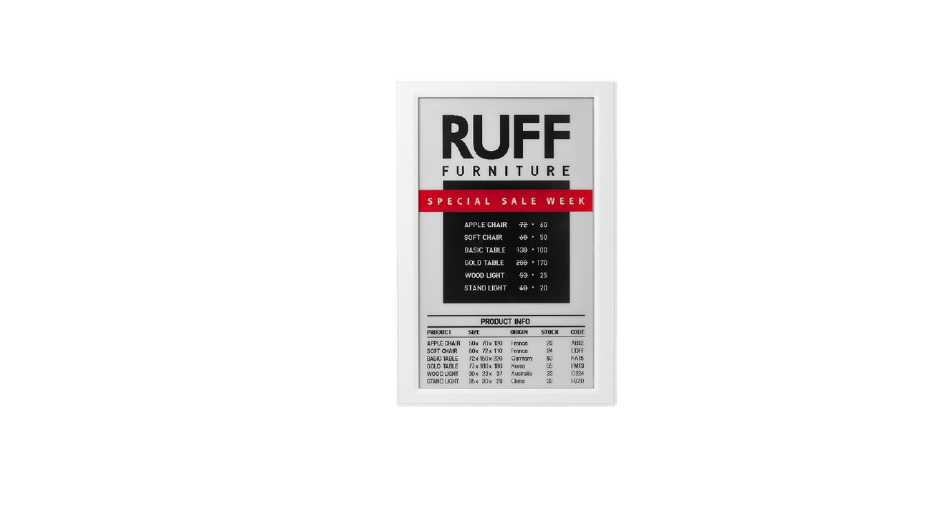

APPENDIX.
LARGE GRAPHIC LABELS
13.3”
7.4”
6.0”
SoluM signage E-label solution for store racks
All promotional information is available in B/W and B/W/R
Multiple page & schedule update support
NFC, QR code, BLE proximity functions are available

Slide 18
APPENDIX.
SYSTEM ARCHITECTURE
ESL System
POS
RFID LABEL System
1
1 Article information
(Article ID – information (including price))
1
Server
Server
Article Information
Article Information
a
a
PDA
Template Information
Template Information
b
b
2
Assignment Information
Assignment Information
2 Assignment
(ESL ID - Article ID)
c
c
3
3 Image rendering with a, b and c
3 Image sending
2
3
3 Image rendering
with a, b and c
3 Image sending
Gateway
2 Assignment
(RFID ID(SIL ID) - Article ID)
Gateway
4
2
4
ESL
……
ESL
SIL
……
SIL
By system
By employee

Slide 19


APPENDIX.
SYETEM INTERWORKING USAGE
Store
Factory
- Massive RFID reading for warehousing
+ RFID Writing (Interrupt) for label activation
- Manufacturing
- Tagging
[Label activation]
- Getting the info using I2C
between RFID and Label
- Info(RFID, A.ID) delivery to server
- Automated assignment
(Label and article)
- Image rendering by server
- Image(Price) display
1234567
5.99
* A.ID : Article ID
[Price changing]
- Receiving the price info from POS
- Image rendering by server
- Image(Price) update
Gateway
- Price changing
Warehouse
- RFID Writing (Article id)
- Massive RFID reading
for delivery
[Label deactivation]
- Receiving the sale info(RFID) from POS
- Automated un-assignment by server
Application server
- Item sold and label deactivation
- Label collection and return (EPC re-writing is possible.)
RFID system
SIL system

Slide 20


APPENDIX.
SYETEM ACTIVATION SCENARIO
Factory
or Recycle warehouse
Store
Stock Room
Show Room
1
2
- RFID writing
- Manufacturing & Repair
Interrupt : Activation
RFID
Disp.
Label
Interface :I2C
NXP RFID, SCL INT, Configure word set (20Bh)
1
2
Interrupt in or to activate label
Label

Slide 21
THANK YOU

